Slide 1

Prototype Submission

Slide 2
TEAM NAME : FALCONS
MEMBER DETAILS
1-Nakul Kolla
2-Eswar Sai Kondragunta
3-Trishal Sai Srinivas
4-Manish Ramireddy
5-G Sudeep Aryan
Road Safety: Technology enablers to reduce accidents, monitor road conditions and city ‘s infrastructure, improve pedestrian safety and monitor the health condition of the drivers
Theme: Smart City Solutions

Slide 3
PROBLEM STATEMENT
As the population is increasing rapidly, the use of vehicles also increasing especially in India, more than 20% of the total vehicles in the world are used in India. The more number of vehicles implies pollution, accidents and more number of safety regulations. 11% of total deaths are due to accidents in India.
Accidents can be mainly caused by drunk & drive and bad health conditions. In the 11% of total accident cases, majority of the cases as high as 6% are due to Drunk and driving while other 2-3% are due to health conditions and irresponsible driving of the driver like, heart conditions, stress levels, dizziness.
In the year 2020, Bangalore city reported 657 deaths due to road accidents. The year’s 2018 and 2019 there were 870 and 832 deaths respectively. So, there are around thousand people dying in Banglore city alone due to road accidents and there may be many people who are out there injured and are going through mental health problems due to accidents. An accident not only affects the person injured but also their respective families.

Slide 4
SOLUTION
So, to reduce the number of road accidents we have come up with a working prototype where the system measures the drivers heartbeat and SPO2 levels continuously and this data is used by the arduino to detect any abnormalities in driver.
Also, an alcohol detection system is integrated with this system and it restricts the driver from starting the engine or with some extra PID controllers we can even limit the maximum speed of the car and also send an alert to the respected authorities along with their emergency contact numbers. In this way we can prevent the life of the driver and also other passengers in the vehicles.
The heartbeat sensor and the SPO2 sensor can be easily integrated to the steering wheel and collect the required data from palms.

Slide 5
Constraints:
1) Some people have a high blood-pressure and heartbeat which is normal to their body. Unfortunately this model won’t be accurate with this case.
2) Some people wear perfumes that contain some alcohol level which may become as a false positive for the sensor.
3) The maximum safe level of the heartbeat vary from person to person according to WHO the maximum safe limit of the person’s heartbeat is around 220-(their age).
Assumptions:
1)The whole city/all the drivers should accept such a device in the car. If this is implemented in some cars there is a chance that the many users may not prefer that particular brand/car.
2) Assume that the driver don’’t wear a mask. If a mask is there then the alcohol sensor which detects the breath would be inaccurate.

Slide 6
How easily can your solution be implemented and how effective will it be?
Our model was developed on the thought of implementing the pulse oximeter sensor in the steering where all the drivers have contact with all the time, so we can keep tracking the health conditions of the driver and make sure they are alert and attentive on roads.
The alcohol sensor is placed over the steering wheel where it would be at 2-3 feet range of the driver’s face to detect the alcohol content through their breath.
The effectiveness of the MQ3 sensor depends on the distance between the sensor and the user. We need to make sure the sensor is placed in a permissible limit.

Slide 7
Usability and Scalability :
This model is not only restricted to the cars in india, it can be used worldwide in all the cars.
This can be further implemented in heavy and long transport vehicles and can be further developed because most of the drivers of these vehicles need to travel long distances so generally they may drive under influence of alcohol, to avoid this and prevent the accidents by restricting the top speed of the vehicle according to the location/road/area it is travelling.

Slide 8
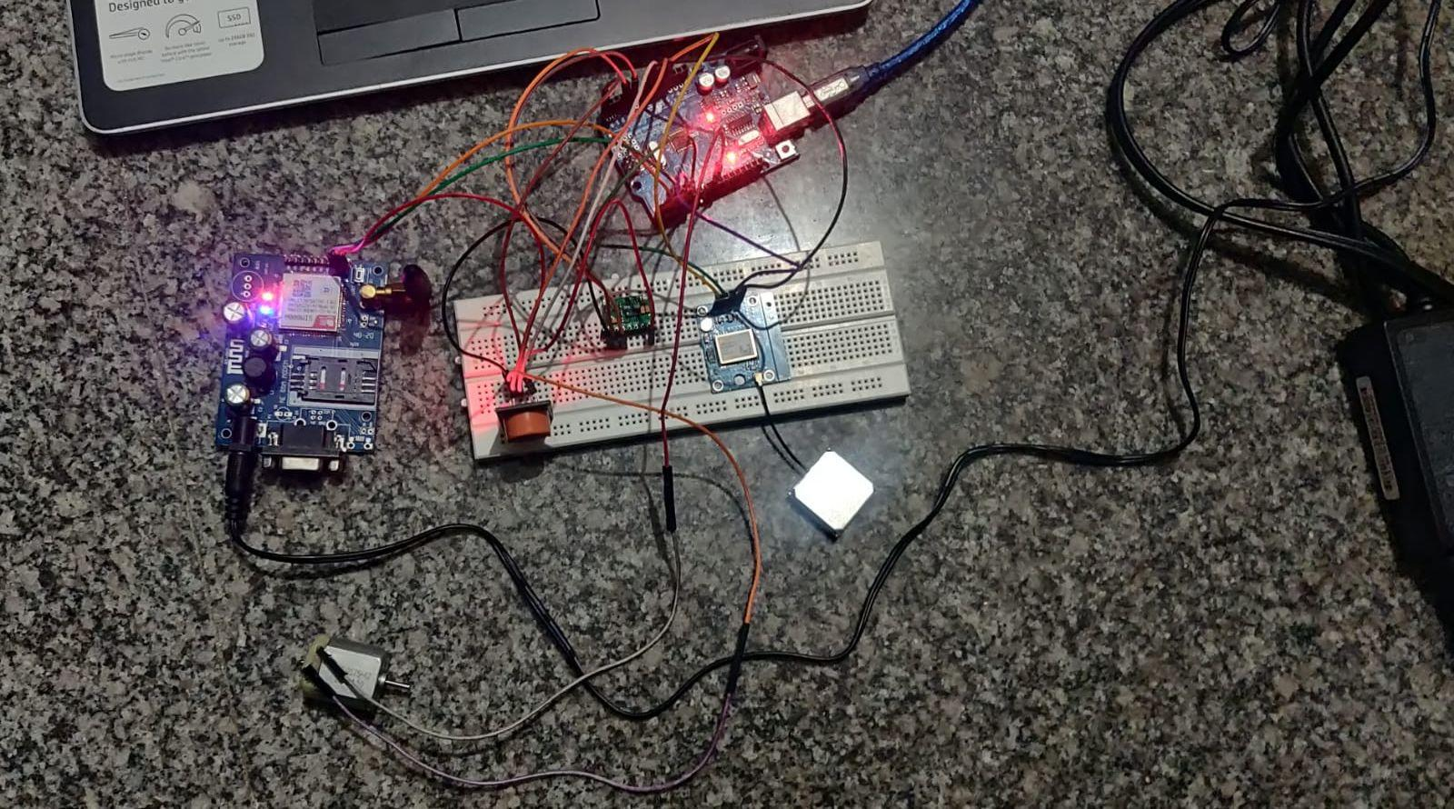
Circuit Model:
Code Text File Link:
https://drive.google.com/file/d/1B_CXGJ_LJ_L30Te_BRpINjhyp_wyNFTz/view?usp=sharing

Slide 9
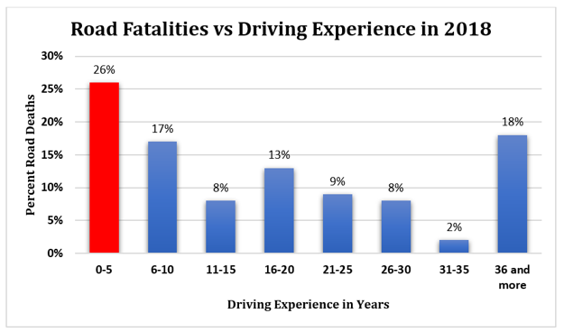
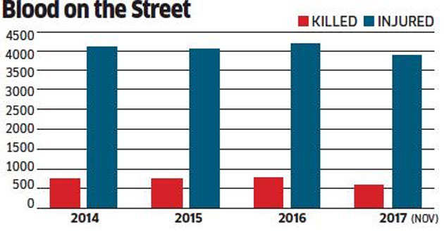
Analysis of Road Accidents:

Slide 10

Components:
MAX 30100 pulse oximeter -
0.96 OLED display
DC Motor
MQ3 Gas sensor
Wifi Module (ESP8266)
GPS Module(Neo-6M GPS)
Technologies:
C Language
Arduino

Slide 11
WORKING PROTOTYPE Video
https://drive.google.com/file/d/1Y6h4I5ko_ANL_tdpZC5E0ajuEX6DlOpE/view?usp=drivesdk

Slide 12
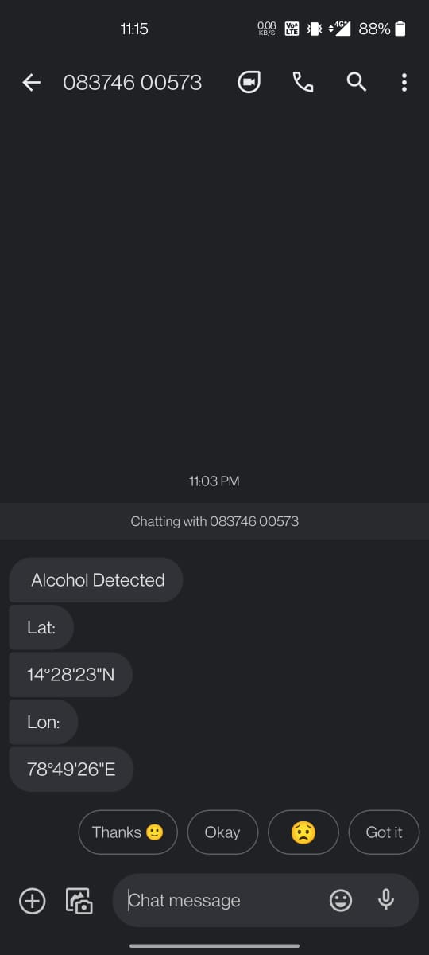
Attachments:
This is a screenshot of the alert system when
alcohol is detected from the driver.

Slide 13

Sober driving today
Alive tomorrow

